Slide 1
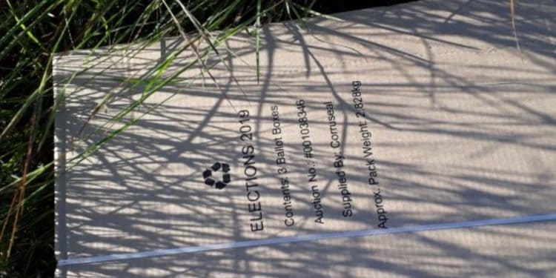
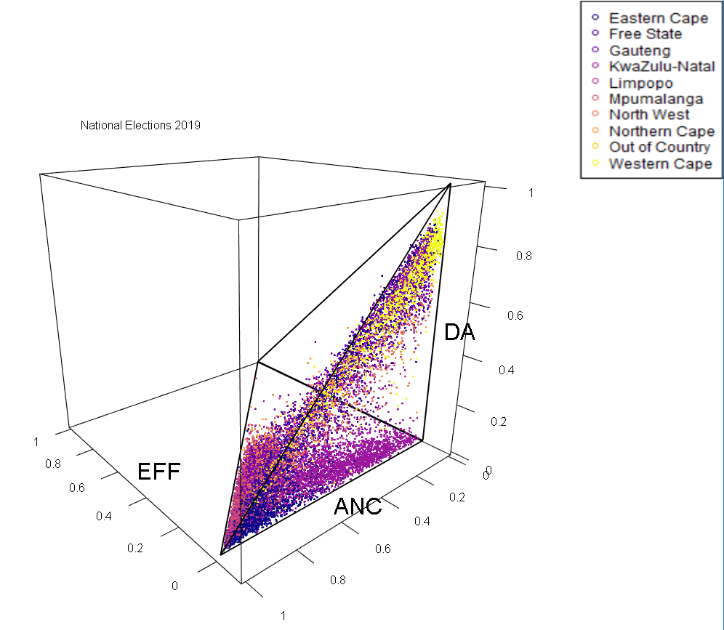
Calculating uncertainty for election results
Sean van der Merwe
Mathematical Statistics and Actuarial Science
University of the Free State
Notes:
In elections it is the proportions that matter, not the votes
Results are reported with certainty; but we know they are not certain
Missing boxes, Modified forms, Double voting, Spoilt ballots, Low turnout, etc.
All non-counted votes are implied to have the same proportions as the average
Let’s report results with accurate uncertainty by filling in the missing values many times
Should be possible with my new Bayesian Dirichlet regression model

